Slide 1
CS305
System Modeling and Simulation
Prof. Dr. Khaled Mahar
khmahar@aast.edu
Lecture 11

Slide 2
Markov Chains (cont.)

Slide 3
Steady State Analysis
Recall that the probability of finding the MC at state i after the k^{th} step is given by
An interesting question is what happens in the “long run”, i.e.,
This is referred to as steady state (long-run behavior) or equilibrium or stationary state probability.
Questions:
Do these limits exists?
If they exist, do they converge to a legitimate probability distribution, i.e.,
How do we evaluate π_{j}, for all j.

Slide 4
Periodicity in Markov chain
A state in a Markov chain is periodic if the chain can return to the state only at multiples of some integer k larger than 1.
Note that even though a state has period k, it may not be possible to reach the state in k steps. For example, suppose it is possible to return to the state in {6, 8, 10, 12, ...} time steps; k would be 2, even though 2 does not appear in this list.
If k = 1, then the state is said to be aperiodic: returns to state i can occur at irregular times. For example return to the state in {1, 2, 3, ...} time steps.
k=gcd{n: p(X_{n}=i|X₀=i>0}.
Notes:
Example: coin tossing with states {start, head, tail} is aperiodic.

Slide 5
Steady State Analysis
Recall the recursive probability
If steady state exists, then π(k) ≈ π(k-1), and therefore the steady state probabilities are given by the solution to the equations
and
For an Irreducible Markov Chain (any state j is reachable from every state i)the presence of periodic states prevents the existence of a steady state probability
Example: periodic states
1
0.5
0
1
2
0.5
1

Slide 6
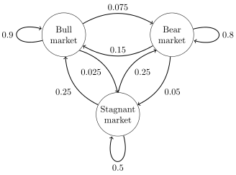
Steady State Analysis (cont.)
Example: Aperiodic states
The states diagram represent whether a hypothetical stock market is exhibiting a bull market, bear market, or stagnant market trend during a given week. According to the figure, a bull week is followed by another bull week 90% of the time, a bear week 7.5% of the time, and a stagnant week the other 2.5% of the time. Labelling the state space {1 = bull, 2 = bear, 3 = stagnant}. Find the steady state transition probability matrix.

Slide 7


Steady State Analysis (cont.)
The transition probability matrix is given by
Using the transition probabilities, the steady-state probabilities indicate that 62.5% of weeks will be in a bull market, 31.25% of weeks will be in a bear market and 6.25% of weeks will be stagnant

Slide 8
Steady State Analysis (cont.)
Theorem: Let P be the transition matrix for an s-state ergodic chain (irreducible-aperiodic-positive recurrent). Then there exists a vector π = [π₁ π₂ … π_{s}] such that
The theorem states that for any initial state i,
Notes:
Positive recurrent: state return time is finite

Slide 9
Birth-Death Example
1-p
1-p
1-p
0
1
i
p
p
p
p
Thus, to find the steady state vector π we need to solve
and

Slide 10
Birth-Death Example
In other words
Solving these equations we get
In general
Summing all terms we get

Slide 11
Continuous Markov Chains

Slide 12
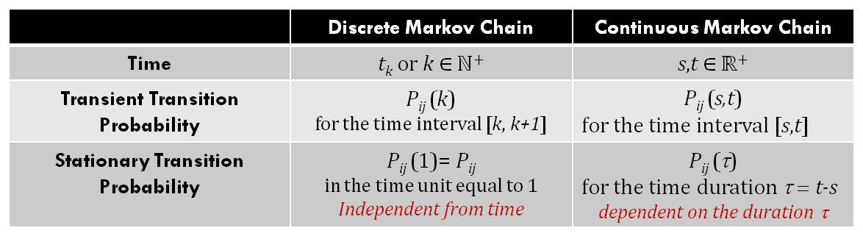
Differences between Continuous-Time and Discrete-Time Markov Chains
 | Discrete Markov Chain | Continuous Markov Chain
Time | t_{k} or k ∈ ℕ⁺ | s,t ∈ ℝ⁺
Transient Transition Probability | P_{ij} (k) for the time interval [k, k+1] | P_{ij} (s,t) for the time interval [s,t]
Stationary Transition Probability | P_{ij} (1)= P_{ij} in the time unit equal to 1 Time duration fixed | P_{ij} (τ) for the time duration τ = t-s dependent on the duration τ
Transition Probability to the Same State | P_{ii} can be different from 0 | P_{ii} (τ)=0 for any τ
Discrete Time
Continuous Time
Variable Time
Fixed Time
τ₁=u-s
τ₂=v-u
τ₃=t-v
τ=1
τ=1
time
time
4
s
u
v
t
0
1
2
3
Events occur at any point in time
Events occur at known points in time

Slide 13
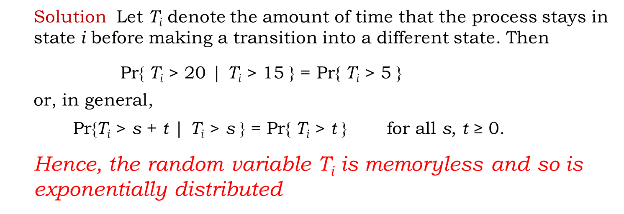
Continuous-Time Markov Chains (cont.)
:Question. Suppose that a CTMC enters state i at time 0 and does not leave during the next 15 minutes; i.e., a transition does not occur. What is the probability that a transition will not occur in the next 5 minutes?
Approach.: Use the memoryless property.
Solution: Let T_{i} denote the amount of time that the process stays in state i before making a transition into a different state. Then
$\text{Pr}\text{\{ }\text{T}\text{i}\text{ > }\text{20 }\text{| }\text{T}\text{i}\text{ > }\text{15 }\text{\} = }\text{Pr}\text{\{ }\text{T}\text{i}\text{ > }\text{5 }\text{\}}$
or, in general,
$\text{Pr}\text{\{}\text{T}\text{i} \text{> }\text{s}\text{ + }\text{t} \text{| }\text{T}\text{i}\text{ > }\text{s}\text{ \} = }\text{Pr}\text{\{ }\text{T}\text{i}\text{ > }\text{t}\text{ \}}$ for all s, t ≥ 0.
Hence, the random variable T_{i} is memoryless and so is exponentially distributed

Slide 14
Definition : Continuous-Time Markov Chains
A stochastic process {X(t), t ≥ 0} is a Continuous-Time Markov Chain (CTMC) if
The amount of time spent in state i before making a transition to a different state is exponentially distributed with rate parameter v_{i},
When the process leaves state i, it enters state j with a probability p_{ij}, where p_{ii} = 0 and
The transition probability out of a state is independent of the time spent in the state)
Summary: The CTMC process moves from state to state according to DTMC, and the time spent in each state is exponentially distributed

Slide 15
Transition Function
Define the transition function (like transition probability in DTMC)
The continuous-time analogue of the Chapman-Kolmokorov equation is
Using the memoryless property
Define H(s,t)=[p_{ij}(s,t)], i,j=1,2,… then

Slide 16
Transition Rate Matrix
Consider the Chapman-Kolmogorov for s ≤ t ≤ t+Δt
Subtracting H(s,t) from both sides and dividing by Δt
Taking the limit as Δt→0
where the transition rate matrix Q(t) is given by

Slide 17
Homogeneous Case
In the homogeneous case, the transition functions do not depend on s and t, but only on the difference t-s thus
It follows that
and the transition rate matrix
Thus
Notes:
Solution of differential equation gives p(t)=Exp(Qt).
Pij(0)=0 means that there is no transition from state I to state j in zero time

Slide 18

State Holding Time
The time the MC will spend at each state is a random variable with distribution
$$G_{i}\left(t\right)=1−e^{−Λ_{i}t}$$
where

Slide 19
Homogeneous Case
The transition rate matrix
q_{ij} is the transition rate that the chain enters state j from state i
ν_{i}=-q_{ii} is the transition rate that the chain leaves state i
Discrete Markov Chain
Continuous Markov Chain
P_{ij}
q_{ki}=ν_{k} . P_{ki}
q_{ji}=ν_{j} . P_{ji}
i
j
k
i
j
P_{ji}
q_{ik}=ν_{i} . P_{ik}
q_{ij}=ν_{i} . P_{ij}
P_{ij}: Transition Probability
Transition Time is deterministic (each slot)
P_{ij}: Transition Probability, q_{ij} input rate from i to j, ν_{i} output rate
Transition Time is random

Slide 20
Continuous Markov Chain
Discrete Markov Chain
P_{ij}
i
j
P_{ji}
P_{ij}: Transition Probability
Transition Time is Known (each slot)
Continuous Markov Chain
q_{ki}=ν_{k} . P_{ki}
q_{ji}=ν_{j} . P_{ji}
k
i
j
q_{ik}=ν_{i} . P_{ik}
q_{ij}=ν_{i} . P_{ij}
P_{ij}: Transition Probability,
q_{ij} input rate of state i from state j,
ν_{i} output rate from state i to
all other neighbor states
Transition Time is randoms

Slide 21
Example: Computer System
Assume a computer system where jobs arrive according to a Poisson process with rate λ.
Each job is processed using a First In First Out (FIFO) policy.
The processing time of each job is exponential with rate μ.
The computer has a buffer to store up to two jobs that wait for processing.
Jobs that find the buffer full are lost.

Slide 22
Example: Computer System
Draw the state transition diagram.
Find the Rate Transition Matrix Q.
Find the State Transition Matrix P

Slide 23
Example: Computer system
λ
λ
λ
0
1
2
3
μ
μ
μ
The rate transition matrix is given by
The state transition matrix is given by

Slide 24

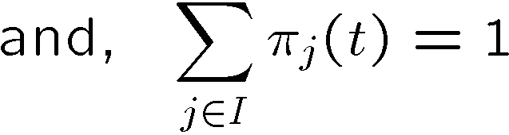

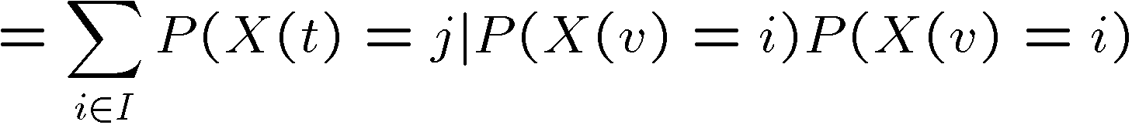
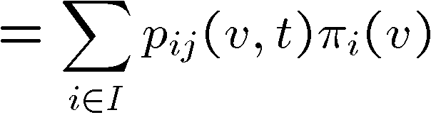
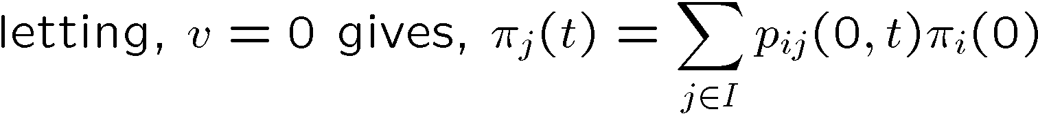
Homogenous CTMCs
is a time-homogenous CTMC iff ,
Or, the conditional pmf satisfies:
Marginal pmf (state probability) is given by:
State prob. May be written as,

Slide 25
State Probabilities and Transient Analysis
Similar to the discrete-time case, we define
In vector form
With initial probabilities
Using our previous notation (for homogeneous MC)
Obtaining a general solution is not easy!
Differentiating with respect to t gives us more “inside”
Notes:
π(0)*(dp(t)/dt)=π(0)*(PQ)=(π(0)*P)Q=π(t)Q

Slide 26
“Probability Fluid” view
We view π_{j}(t) as the level of a “probability fluid” that is stored at each node j (0=empty, 1=full).
Change in the probability fluid
outflow
inflow
i
r
q_{ij}
q_{jr}
…
j
…
Inflow
Outflow

Slide 27
Steady State Analysis
Often we are interested in the “long-run” probabilistic behavior of the Markov chain, i.e.,
These are referred to as steady state probabilities or equilibrium state probabilities or stationary state probabilities
As with the discrete-time case, we need to address the following questions
Under what conditions do the limits exist?
If they exist, do they form legitimate probabilities?
How can we evaluate these limits?

Slide 28
Steady State Analysis
Theorem: In an irreducible continuous-time Markov Chain consisting of positive recurrent states, a unique stationary state probability vector π with
These vectors are independent of the initial state probability and can be obtained by solving
Using the “probability fluid” view
i
r
outflow
q_{ij}
q_{jr}
…
j
…
0 Change
inflow
Inflow
Outflow

Slide 29
Example: Computer System
λ
λ
λ
0
1
2
3
μ
μ
μ
For the previous example, with the above transition function, what are the steady state probabilities
Solve

Slide 30
Example: Computer System
The solution is obtained

